Slide 1
Continuous testing

Slide 2
Outline
Business context
Factors affecting tests
test data and pipeline
Tooling
Testing in agile development

Slide 3
Who is building the system?
The testing strategy will depend on who builds which portions of the system.
The system is owned and delivered to end users by the “owning organization”
The owning organization may utilize subcontractors to build all or a portion of the system.
The system may utilize externally developed dependencies (e.g. libraries)

Slide 4
Test suite
A test suite consists of
Software to be tested
Tests to be run
Results of the tests

Slide 5
Test Suites and the owning organization
The owning organization has control of the test suites for those portions of the system built in-house
The owning organization may control tests to be run and results of these tests for sub-contractors (depending on the contract)
The owning organization has no control over test suites for externally developed dependencies.

Slide 6
Perspective of the owning organization
The owning organization is responsible for the quality of the system
The owning organization can only control portions of the test suites.
==>

Slide 7
Perspective of owning organization
The owning organization must review (and possibly repeat) tests on sub-contracted portions of the system
The owning organization must develop test suites for externally developed dependencies.
The owning organization can only perform some types of tests on portions for which it has the source code

Slide 8
When to perform tests
In general, the owning organization should perform tests as soon as it is possible.
Unit tests
For in house developed code before module is committed to version control system
For externally developed dependencies, as soon as dependencies and their uses are identified
If sub-contracted code is delivered as modules, then for each module.

Slide 9
When to perform tests
Unit of deployment tests
When the unit of deployable is available
From build environment
delivered (from sub-contractor
Downloaded from external source

Slide 10
Outline
Business context
Factors affecting tests
test data and pipeline
Tooling
Testing in agile development

Slide 11
Factors affecting tests
Granularity
Stability
Automated vs manual

Slide 12
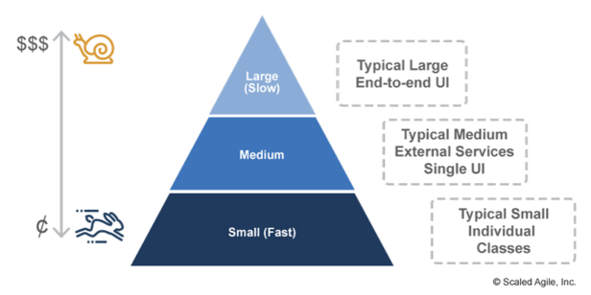
Testing in General
Have as many cheap, fast running tests as possible and minimize the number of expensive and slow tests

Slide 13
Smaller is better
Both modules and units of deployment
Changes can be better localized
Easier test coverage
Supports continuous deployment

Slide 14
Stability
Changes complicate automation
Suppose you have test script for a module
You make changes to module
Does script still work?
It depends on the changes.
If you fixed an error, then script should still work
If you added functionality, the existing script would not test new functionality.

Slide 15
Changes to modules propagate
A unit of deployment is made up of multiple modules integrated together
System tests may not reflect newly added functionality.
API changes may not be reflected in test scripts.

Slide 16
Automated testing positives
Easy to invoke
Repeatable
Recorded in version control
Can be reviewed

Slide 17
Automated testing negatives
Cost in developing /modifying test scripts
May be multiple target environments – e.g. Uis for smartphones

Slide 18
Best practice
Modifications should be accompanied by changes to test scripts.
Developers responsible for test scripts
Alerts when version/release of externally developed dependencies change

Slide 19
Outline
Business context
Factors affecting tests
Test data and pipeline
Tooling
Testing in agile development

Slide 20
Test inputs
Input for tests can come from
Test script
Record/playback
“Tee”ing actual input
Test generation tool
Data base

Slide 21
Test data base
Need to worry about exposing private data to developers
Limited (depending on environment) so that tests will run fast and keep build queue from growing
If tests change database, it must be refreshed before next set of tests.
No results should be sent to any production service – results in corrupting production version.

Slide 22
Testing in Development Environment
Unit Testing/component testing
Verify the functionally of specific section of code
Includes static code analyzers, data flow, metrics analysis or peer code reviews
Acceptance Testing
Done by developer prior to integration or regression
Smoke/Sanity Testing
Reasonable to proceed with further testing or not
Minimal attempts to operate software

Slide 23
Functional testing in CI server
Created image is subjected to a collection of automated tests
Tests are performed using a test harness
Tests are the result of
User stories
Regression tests
Rainy day scenarios
Trade off between comprehensiveness of tests and time it takes to run the tests
CI server reports results through e-mail or a web page.

Slide 24
Testing in CI Environment
Much like testing in the development environment except with multiple modules rather than a single one
Unit Testing/component testing
Built system testing
Detect defects in the interface and interaction between modules
Module/subsystem integration

Slide 25
Testing in Staging Environment
Regression testing
Smoke testing
Compatibility testing
Integration testing
Functional Testing
Usability Testing
Install/uninstall testing
Performance testing
Security testing

Slide 26
User Tests
Real (or simulated) users exercise the system.
Having real users is expensive and difficult to ensure coverage.
Record/playback works in some contexts
Teeing actual input works in some contexts
Having real users allows for exception testing in a better fashion than automated tests
Must consider different screen size or resolution for mobile devices.

Slide 27
Performance tests
Test for performance with generated loads
Environment should be as real as possible
Load balanced
Auto scaled
Multiple instances

Slide 28
Test Database in Staging environment
Use as close to real data as possible.
One organization uses database that is one hour old (created as a back up by cloud vendor).
Constraints
Restore database after each test
Keep personal information private

Slide 29
Security testing
Common Vulnerabilities and Exposures data base (CVE)
Buffer overflow
SQL injection
Penetration testing tools
Static analyzers
Fuzz Testing
Model checking

Slide 30
Outline
Business context
Factors affecting tests
Test data and pipeline
Tooling
Testing in agile development

Slide 31
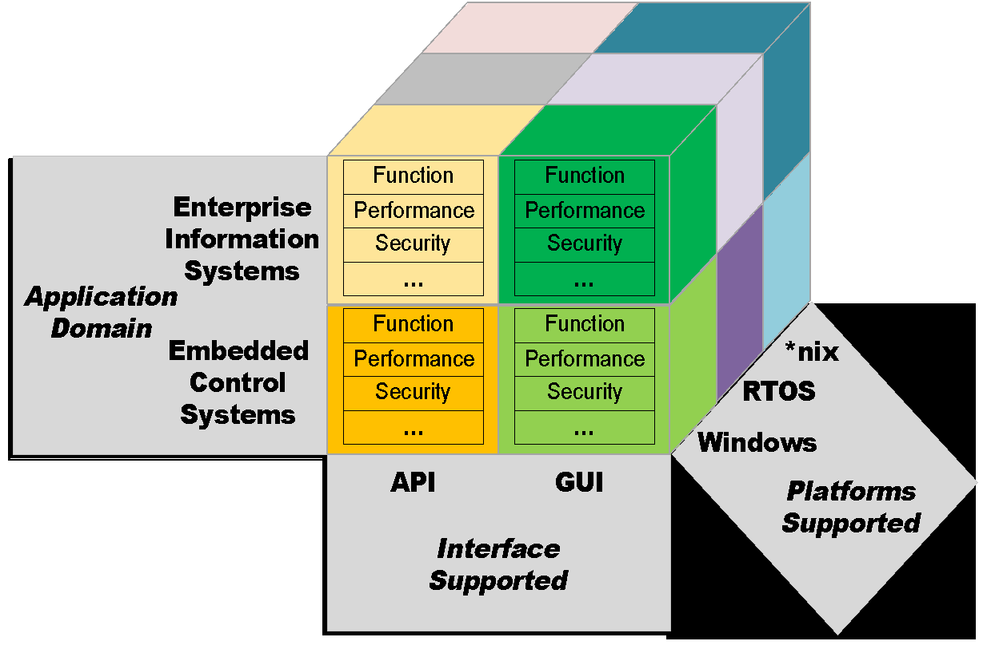
Tools for Test Automation
There are hundreds of software testing tools
Each tool is specialized for a certain kind of testing
Each tool is specialized for a tool stack, target stack, and target interface

Slide 32
Tool types
Direct tests
Service virtualization
Generated tests
Test life cycle management

Slide 33

Direct test generation
Test harness
App
Test
script
Developer generates test script that is executed by test harness

Slide 34
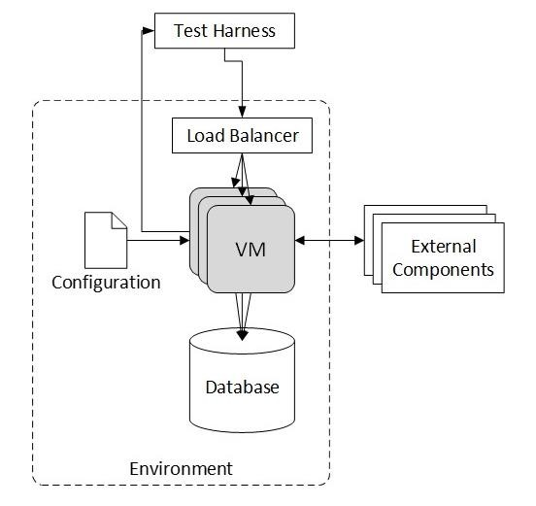
Test Harness
A test harness uses a script to generate inputs and compares outputs to verify the correctness of the code.
Load balancer is included so that initiation/shutdown of portions of the system can be tested.
34

Slide 35
Types of direct testing tools
Performance
Security
Function
UI

Slide 36
Tool types
Direct tests
Service virtualization
Generated tests
Test life cycle management

Slide 37
External components
External components may be
Not yet completed
Still evolving
Controlled by a third-party or partner
Available for testing only in limited capacity or at inconvenient times
Difficult to provision or configure in a test environment
Needed for simultaneous access by different teams with varied test data setup and other requirements
Restricted or costly to use for load and performance testing

Slide 38
Service virtualization
Service virtualization emulates the behavior of external software components
A form of mocking or stubbing that allows higher fidelity emulation than either mocking or stubbing.
Tools exist to create the virtualized service.

Slide 39
Creating the virtualized service
Recording live communication among components as the system is exercised from the application under test
Providing logs representing historical communication among components
Analyzing service interface specifications (such as a WSDL)
Defining the behavior manually with various interface controls and data source values

Slide 40
Record/playback
Service exists and is available
Insert recorder that records both requests and responses
Use recording to simulate service
Client
Recorder
Service

Slide 41
Using specification
Requires that a specification exists for the service
WDSL
API definition – Swagger, protocol buffers

Slide 42
Tool types
Direct tests
Service virtualization
Generated tests
Test life cycle management

Slide 43
Generated tests
An emerging class of tools will generate tests automatically. These are called Autonomous Test Generation (ATG) tools
They use AI/ML to create and drive software testing.

Slide 44
Test generation tools must be trained
Whenever you see “AI” or “ML”, there is a training phase involved.
Generative test tools are trained on existing test cases and results.
They can also be trained on natural language user stories.
If you have an existing suite of test cases for a system, then you can use that existing suite to generate a model for the test generation tool.
The model will create (and execute) additional tests for your application.

Slide 45
Limitations of test generation tools
Test generation tools will create additional tests for existing applications.
Adding new functions requires that the tool be retrained.
If it is possible to enter natural language user stories for functions as a portion of the training process, then the user stories for the new functions will help train the tool.
These tools are just emerging and will likely evolve and improve in the future.

Slide 46
Tool types
Direct tests
Service virtualization
Generated tests
Test life cycle management

Slide 47
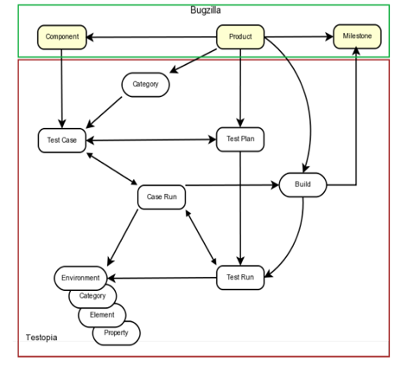
Test Asset Management System
Team-wide repository, test meta-data
Tool chain interfaces
Test harness(es)
Bug tracking
Requirements
Version control
Continuous integration
Part of Application Lifecycle Management (ALM) systems
Greg Hendricks. Software Testing With Testopia

Slide 48
Outline
Business context
Factors affecting tests
test data and pipeline
Tooling
Testing in agile development

Slide 49
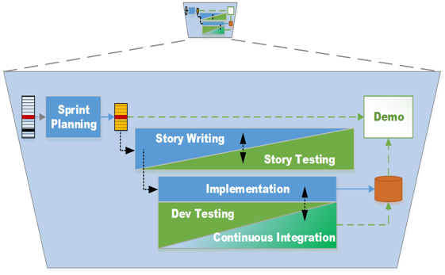
Agile intermingles Development and Test
How is testing different in Agile software development?
Development and test are not separate or standalone
Tests are added to a repeatable test suite
Test suite is repeated for each change
Demos not a replacement for testing
Team Backlog

Slide 50
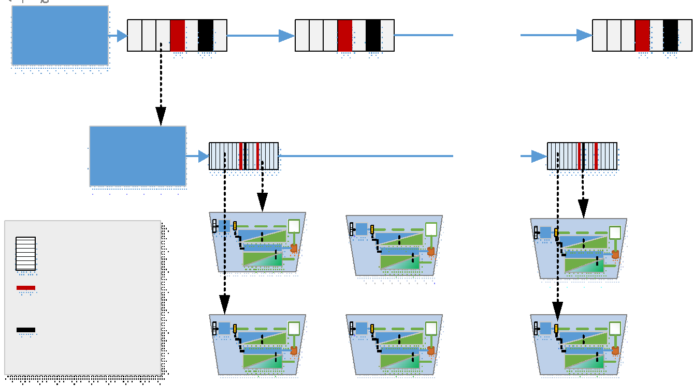
Agile iteration relies on more testing earlier
How is testing different in Agile software development?
Testing used for rapid refinement of loosely understood requirements, architecture, and design
Requirements and implementation are finely sliced
Each slice is tested immediately and repetitively
Portfolio Backlog
Value Stream Backlog

Slide 51
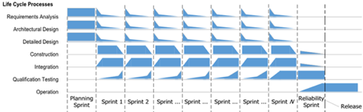
Agile testing for sprints
How is testing different in Agile software development?
Testing performed at each stage of software development life cycle
Requirements
Design
coding
Agile testing cadence
Test, fail, code, test, pass
…
Test, fail, code, test, pass
Release
The end of each sprint is clean in terms of errors
Source: IEEE Standard 1633P, Recommended Practices for Software Reliability Engineering

Slide 52
Summary
Testing strategy will depend on when owning organizations gains control of software.
Testing strategy is affected by granularity of items being tested, how frequently they change, and what type of tools are available.
Different portions of the pipeline are used for different types of tests
Direct testing scripts are generated by the developer.

